Slide 1
MeanShift Parallelization
Group 46 游承翰 陳彥凱

Slide 2
Outline
Introduction
Implementation
Optimization
Experiment and Analysis

Slide 3
Introduction

Slide 4
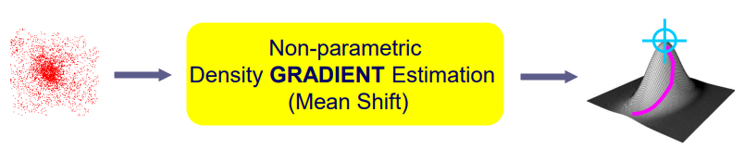
What is MeanShift
A non-parametric iterative algorithm used for feature space analysis
Find modes in a set of data samples, manifest an underlying probability density function (PDF) in R^{N}

Slide 5
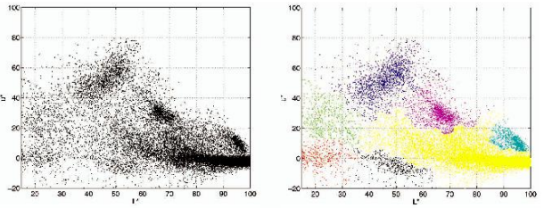
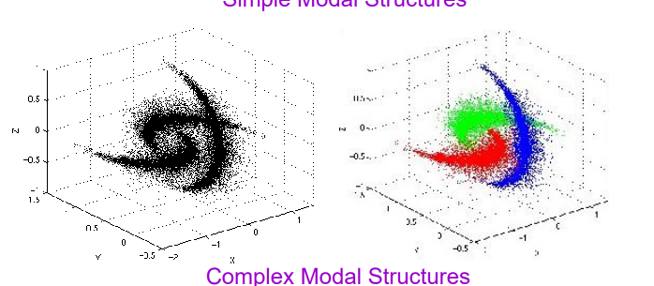
Use Case
Clustering: It's commonly used when the number of clusters is not known in advance.

Slide 6
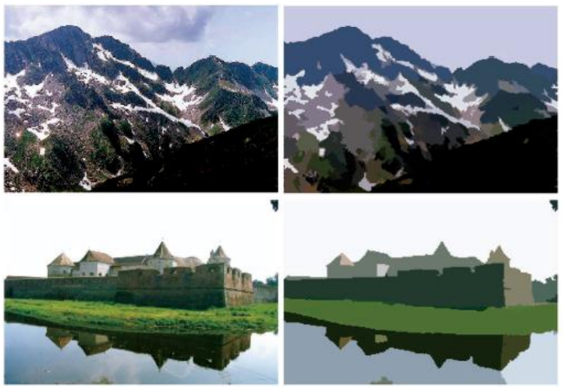
Use Case
Image Segmentation: Segment an image into different regions based on the distribution of color intensities or texture features.

Slide 7
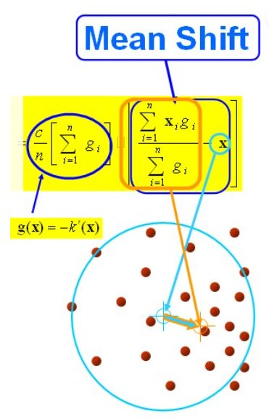
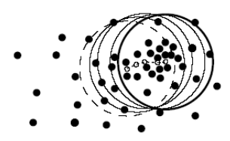
Core Concept
Complexity: O(MN²)
M = num of iterations, N = num points (pixels in our case)

Slide 8
Implementation

Slide 9
Sequential Version
Start
Given the center of initial search area circle
Traverse pixel points within bandwidth and calculate the weight of each point
Set the center to mean (each weight * RGB value of each pixel)
Calculate the mean shift vector and check if norm < ε
End

Slide 10
Parallel Version
Start
For all pixels, independently
Given the center of initial search area circle
ˋˋ
calculate the weight of each point within bandwidth
ˋˋ
Set the center to mean (each weight * RGB value of each pixel)
Calculate the mean shift vector and check if norm < ε
End

Slide 11
Parallel Version

Slide 12
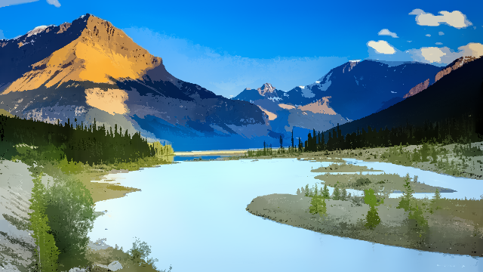
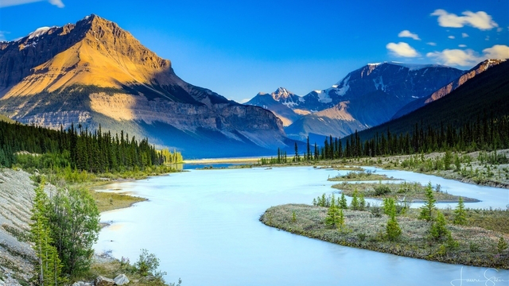

Visualization Result
bandwidth = 15
bandwidth = 40

Slide 13
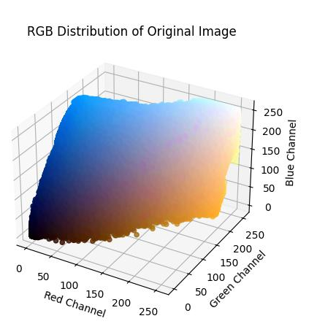
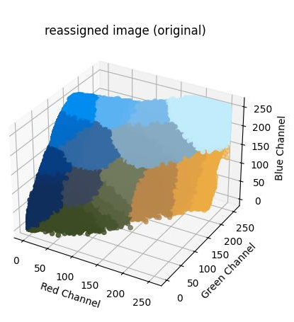
Visualization Result
RGB Distribution of Reassigned Image

Slide 14
Optimization

Slide 15
How to optimize
CPU -> GPU baseline
Coalesced Memory Access
Shared Memory
Unroll
(Add spatial information)

Slide 16
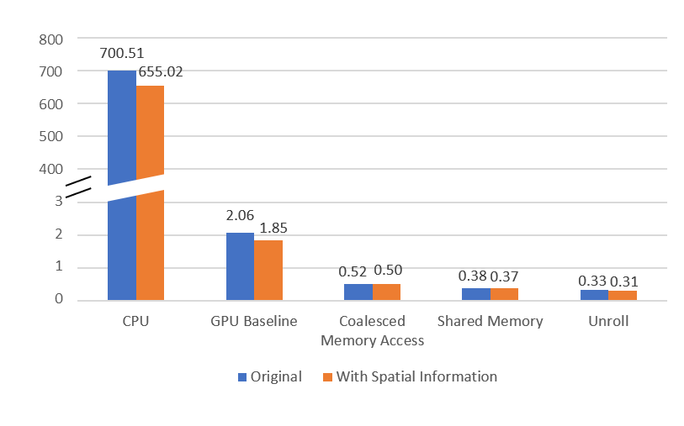
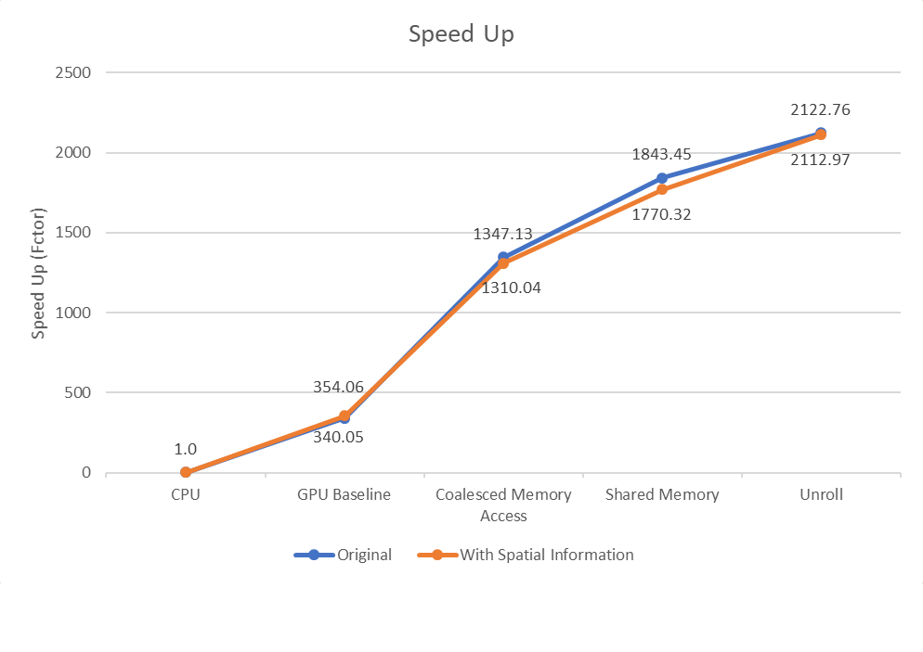
Performance Optimization
Performance Optimization
Time (s)
Optimization
Optimization

Slide 17
Experiment and Analysis

Slide 18
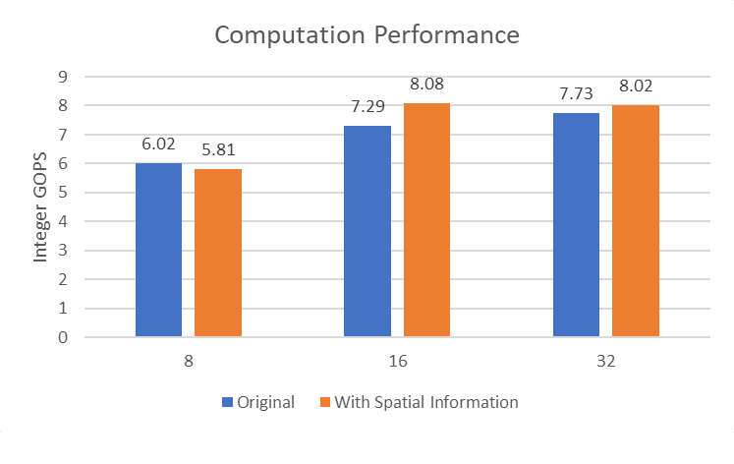
Integer GOPS
Block Size

Slide 19
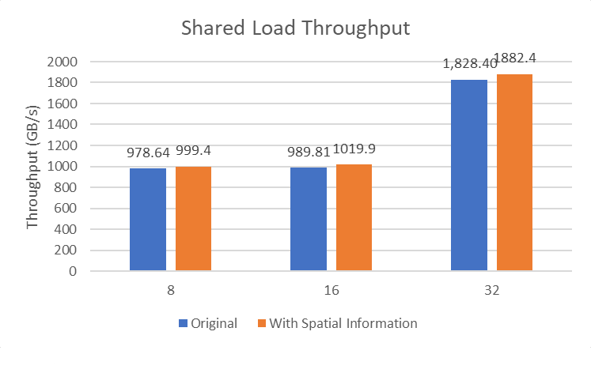
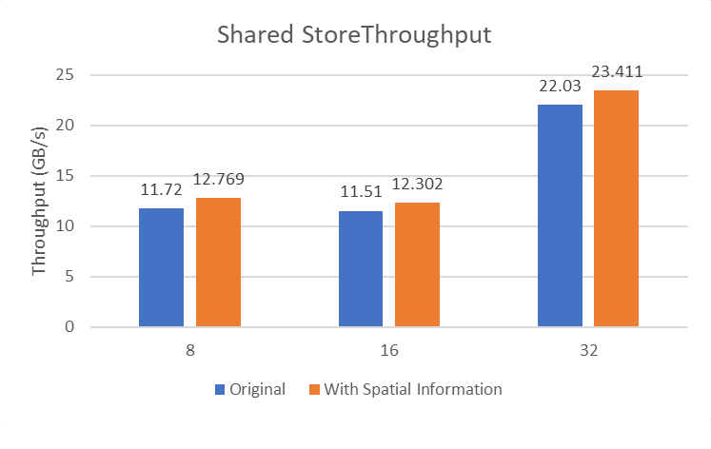
Shared Memory Throughput
Shared Store Throughput
Block Size
Block Size

Slide 20
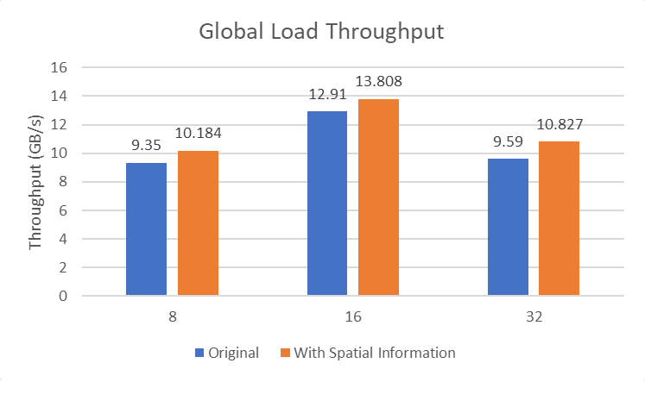
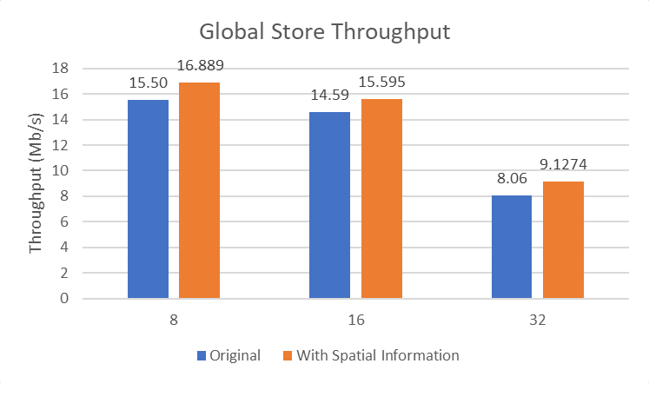
Global Memory Throughput
Block Size
Block Size

Slide 21
Reference
均值漂移(Meanshift)算法流程_meanshift均值漂移算法-CSDN博客
meanshift算法图解-CSDN博客
DL、ML筆記(七): Clustering Algorithm(K-means、MeanShift、DBSCAN) - JianJie - Medium
CS6550 Unit5-Segmentation slides

Slide 22
Thanks
Group 46 游承翰 陳彥凱

